Slide 1
INVESTMENT CASE STUDY SUBMISSION
Group Name:
Sweta Kumari
Manish Anand
Annamalai Ganapathy
Jayakrishna Chakkirala

Slide 2
<Abstract>
The objective of this case study is facilitate Sparks Funds, an asset management company in making investments on other companies with below constraints:
It can invest between 5 to 15 million USD per round of investment.
It wants to invest only on English Speaking countries.
This case study helps Sparks Funds in understanding the market trend for investment by analyzing the below important factors:
Investment Type : This would help in narrowing down the best investment types suited for Sparks Funds to invest as it has constraints of investment amount.
Country : This would help in narrowing down the best suited English speaking countries for investment.
Sectors : This is the main factor for investment as it helps Sparks funds in deciding the main sector and primary sector best suited for investment.
All the above factors play key role for Sparks Funds in deciding the company name that it would prefer to invest with the constraints.In the end we would have the top 3 countries with the maximum number of investments in each sector.

Slide 3
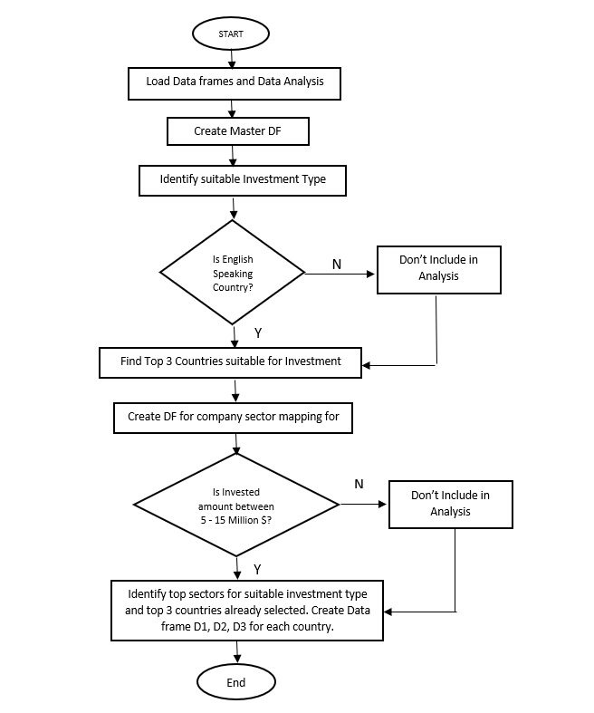
Problem solving methodology:

Slide 4
Funding Type Analysis
Steps undertaken for Investment Type Analysis :
Step 1: Load the data into data frames companies and rounds2
Step 2: Data cleaning for encoding issues
Step 3: Create master data frame by merging companies and rounds2 on attribute permalink/company_permalink
Step 4: Clean master data frame to only include companies with no null values for raised_amount
Step 5: Find the average amount raised by individual funding type
As Sparks Funds can invest in range of 5 -15 million dollars per round of investment we need compare the investment amounts in the venture, seed, angel, private equity etc. As seed/angel funding are for early startups and private equity involves a huge money for investment , Venture funding type seems appropriate investment type for Sparks Funds.
Assumptions : Companies with closed status is also considered in data analysis.

Slide 5
Country Analysis
Spark Funds wants to invest in countries with the highest amount of funding for the chosen investment type.
Step 1: Based on the selected investment type , ie Venture type in our case , filter the master data frame.
Step 2: Filter the data frame for only English speaking countries
Step 3: Find the sum of raised_amount for each country from the filtered data frame in step 2.
Step 4: Create data frame Top9 for the top 9 countries sorted in ascending order of the amount raised for Venture type funding.
Step 5: Determine the top 3 countries from the data frame Top9
As Sparks Funds prefers to invest in only English speaking countries, we need first filter the English speaking countries from the data frame for investment type Venture and then sort them in ascending order of amounts raised.
Top 3 countries for Sparks Funds potential investment :
USA
Great Britain
India

Slide 6
Sector Analysis

Slide 7
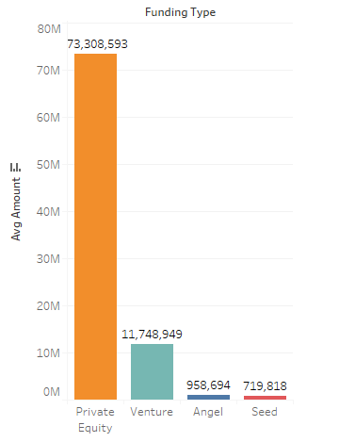
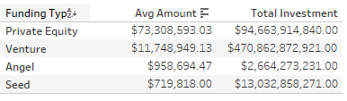
Results:Investment Type Analysis

Slide 8
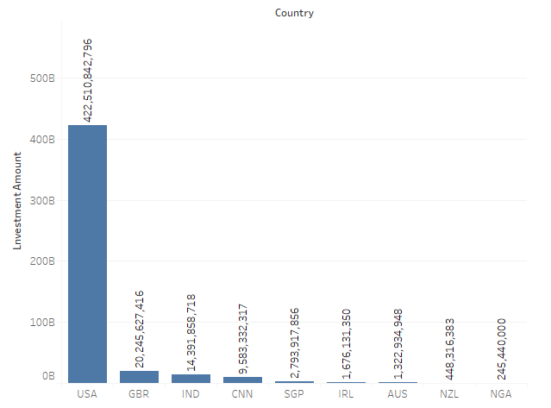
Results: Countries Analysis

Slide 9
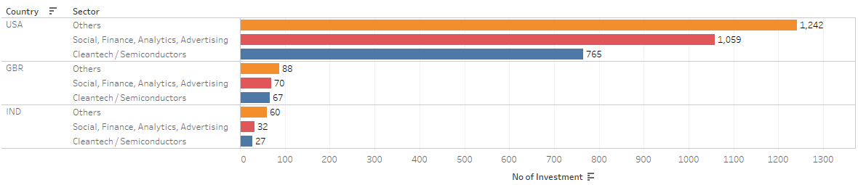
Results: Sector Analysis

Slide 10
<Conclusions>

